Slide 1
Project 2: Text Visualization
DDL: 11.29 24:00
Email: infovis2@163.com

Slide 2
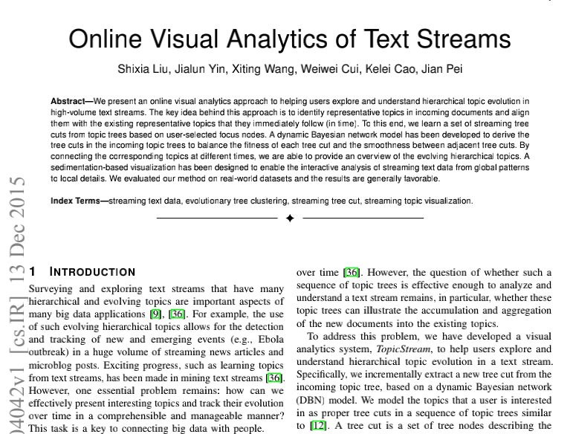
Task
Text source: https://arxiv.org/pdf/1512.04042.pdf
Treat the entire paper as a corpus, treat each subsection as a document

Slide 3
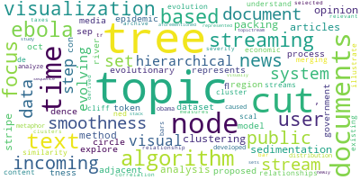
Task
Python wordcloud package

Slide 4
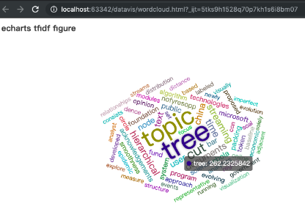
Task
JavaScript echartsCloud

Slide 5
Step1: Pre-process
Convert PDF to TXT/CSV
Delete figures, tables and references
Upper case to lower case
……

Slide 6
Step2: Text Analysis
Tokenization
TF Model: Term frequency
TF-IDF Model: Inverse document index
$$IDF\left(x\right)=log\frac{N}{N\left(x\right)+1}$$
$$TF−IDF\left(x\right)=TF\left(x\right)∗IDF(x)$$

Slide 7
Step3: Visualization
Python wordclound (static figure)
http://amueller.github.io/word_cloud/
Python pyecharts
https://github.com/pyecharts/pyecharts
JavaScript echartsCloud (interactive html view)
https://github.com/ecomfe/echarts-wordcloud
……

Slide 8
参考资料
英文常用停用词表：https://blog.csdn.net/oyezhou/article/details/83059359
pdfminer, jieba, sklearn, wordcloud，pyecharts
文本数据挖掘项目
https://www.jianshu.com/p/96b983784dae

Slide 9
作业要求
10个学时（两周）内实现上述功能
提交报告与代码
报告：问题描述、实现方法流程、实现细节、实验结果展示
代码：核心代码（可读性的注释，结果可复现），配置文件

